Slide 1
Capstone Project 10
Analysis on Incident Audit Logs
Sanjose N
Data Engineering Batch

Slide 2
Problem Statement
To build a comprehensive data pipeline that automates data ingestion, transformation, storage, and visualization for Incident audit logs analysis.
By leveraging Azure Data Factory for ingestion, Databricks (with PySpark and Spark-SQL) for transformation, and a flexible visualization layer.

Slide 3
Data Sources
High Impact Data
Medium Impact Data
Low Impact Data
CSV format
HTTP
CSV format
Blob Source
SQL Table
SQL DB

Slide 4
Solution Flow
Tech Stack
Azure Data Factory - For pipeline run and data ingestion
Azure Cosmos DB - Landing Zone
PySpark – For Transformations and Aggregation
SparkSQL – For Visualization
Azure Databricks – For Dashboard

Slide 5
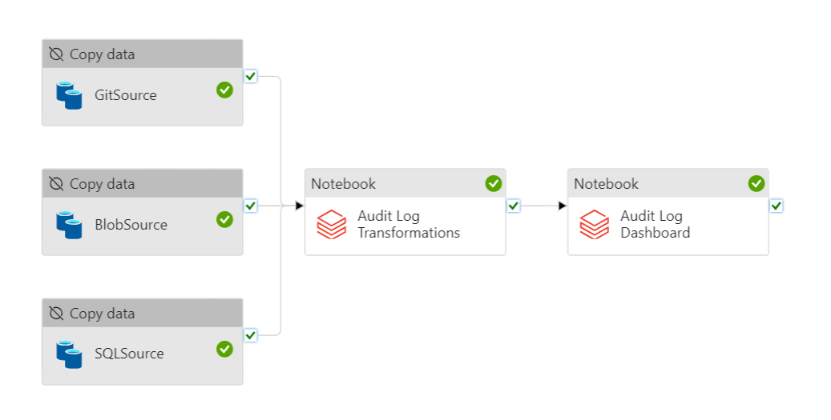
Solution Flow - pipeline

Slide 6
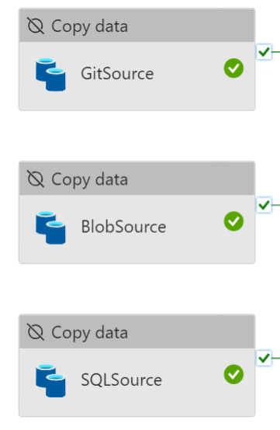
Solution Flow - pipeline
Data Ingestion

Slide 7
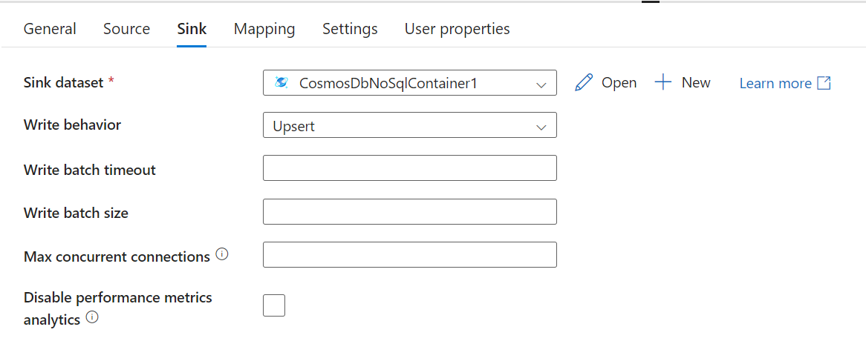
Solution Flow - pipeline
Cosmos Storage

Slide 8
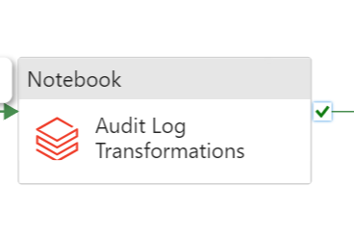
Solution Flow - pipeline
Data Cleaning & Transformation

Slide 9
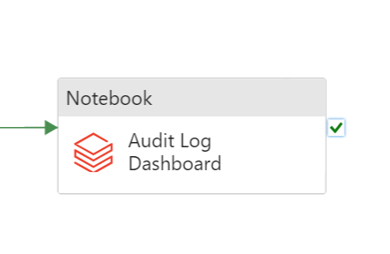
Solution Flow - pipeline
Data Visualization

Slide 10
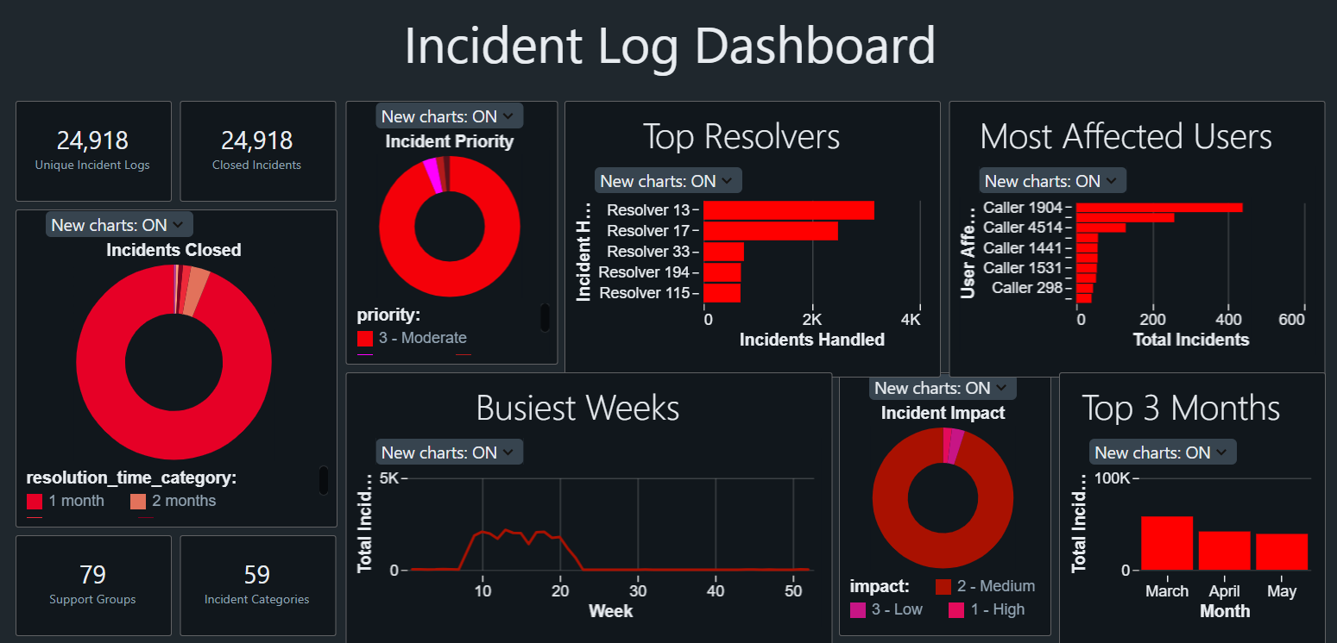
Dashboard

Slide 11
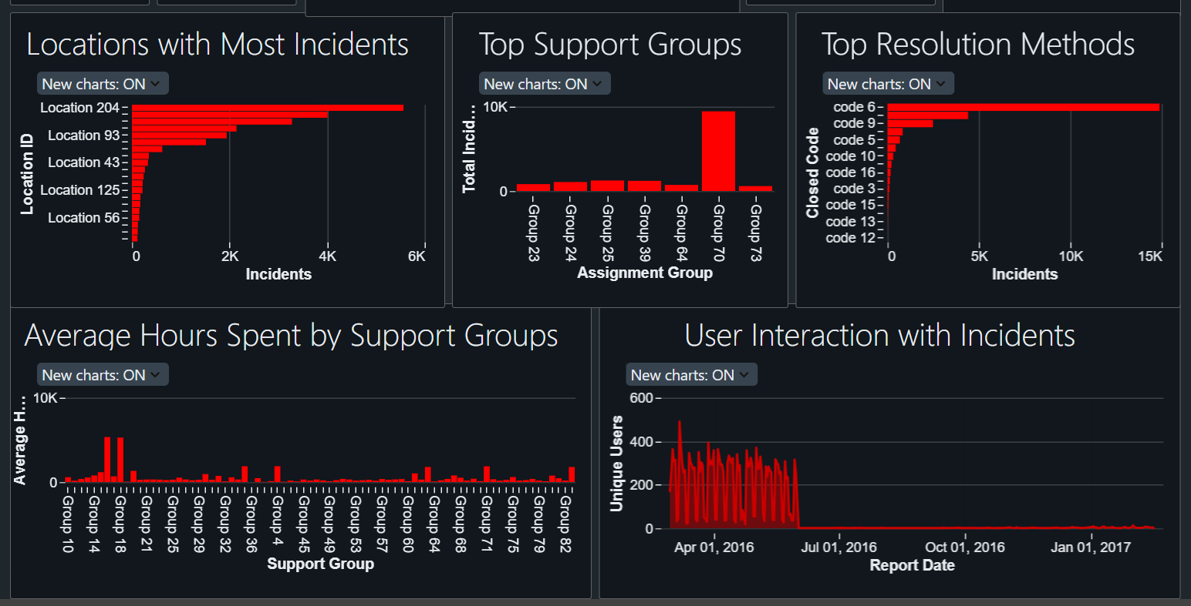
Dashboard

Slide 12
Insights
From the data the following insights have been derived:
Most incidents are of moderate priority only.
March, April and May are the top 3 months with the highest number of incidents.
Group 70 is the support group that resolved the highest number of incidents.
Location 204 has the most number of incidents.
Code 6 is the best resolution method which resolved almost 15000 incidents.
Most number of incidents were reported on March -07-2016 and was reported by 490 unique users.
Most of the incidents are resolved within a time period of One month.
The best resolver with highest number of incident handling is Resolver 13.
Caller 1904 is the most affected user of all.

Slide 13
Challenges Faced
There was a huge amount of null values in the data.
Struggled with selecting effective charts and graphs for visualization.
Encountered challenges in maintaining quality and consistency of data.
Faced difficulties in execution of pipeline.

Slide 14
THANK YOU

